Slide 1
Bike rental demand
Axel Reman

Slide 2
01
How many bikes should be available?
(AI)

Slide 3
Data =
Date & time information
Weather patterns
Working or not
Historical rental data

Slide 4
EDA
Mild seasonal patterns
Nice weather makes an impact
Differing peak hours

Slide 5
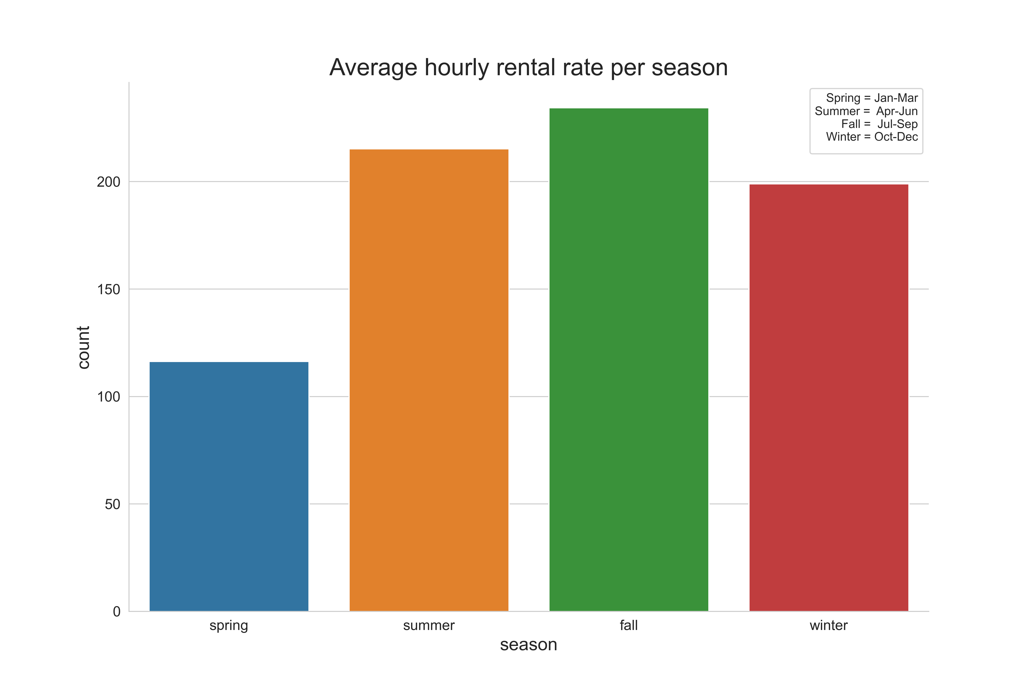

Slide 6
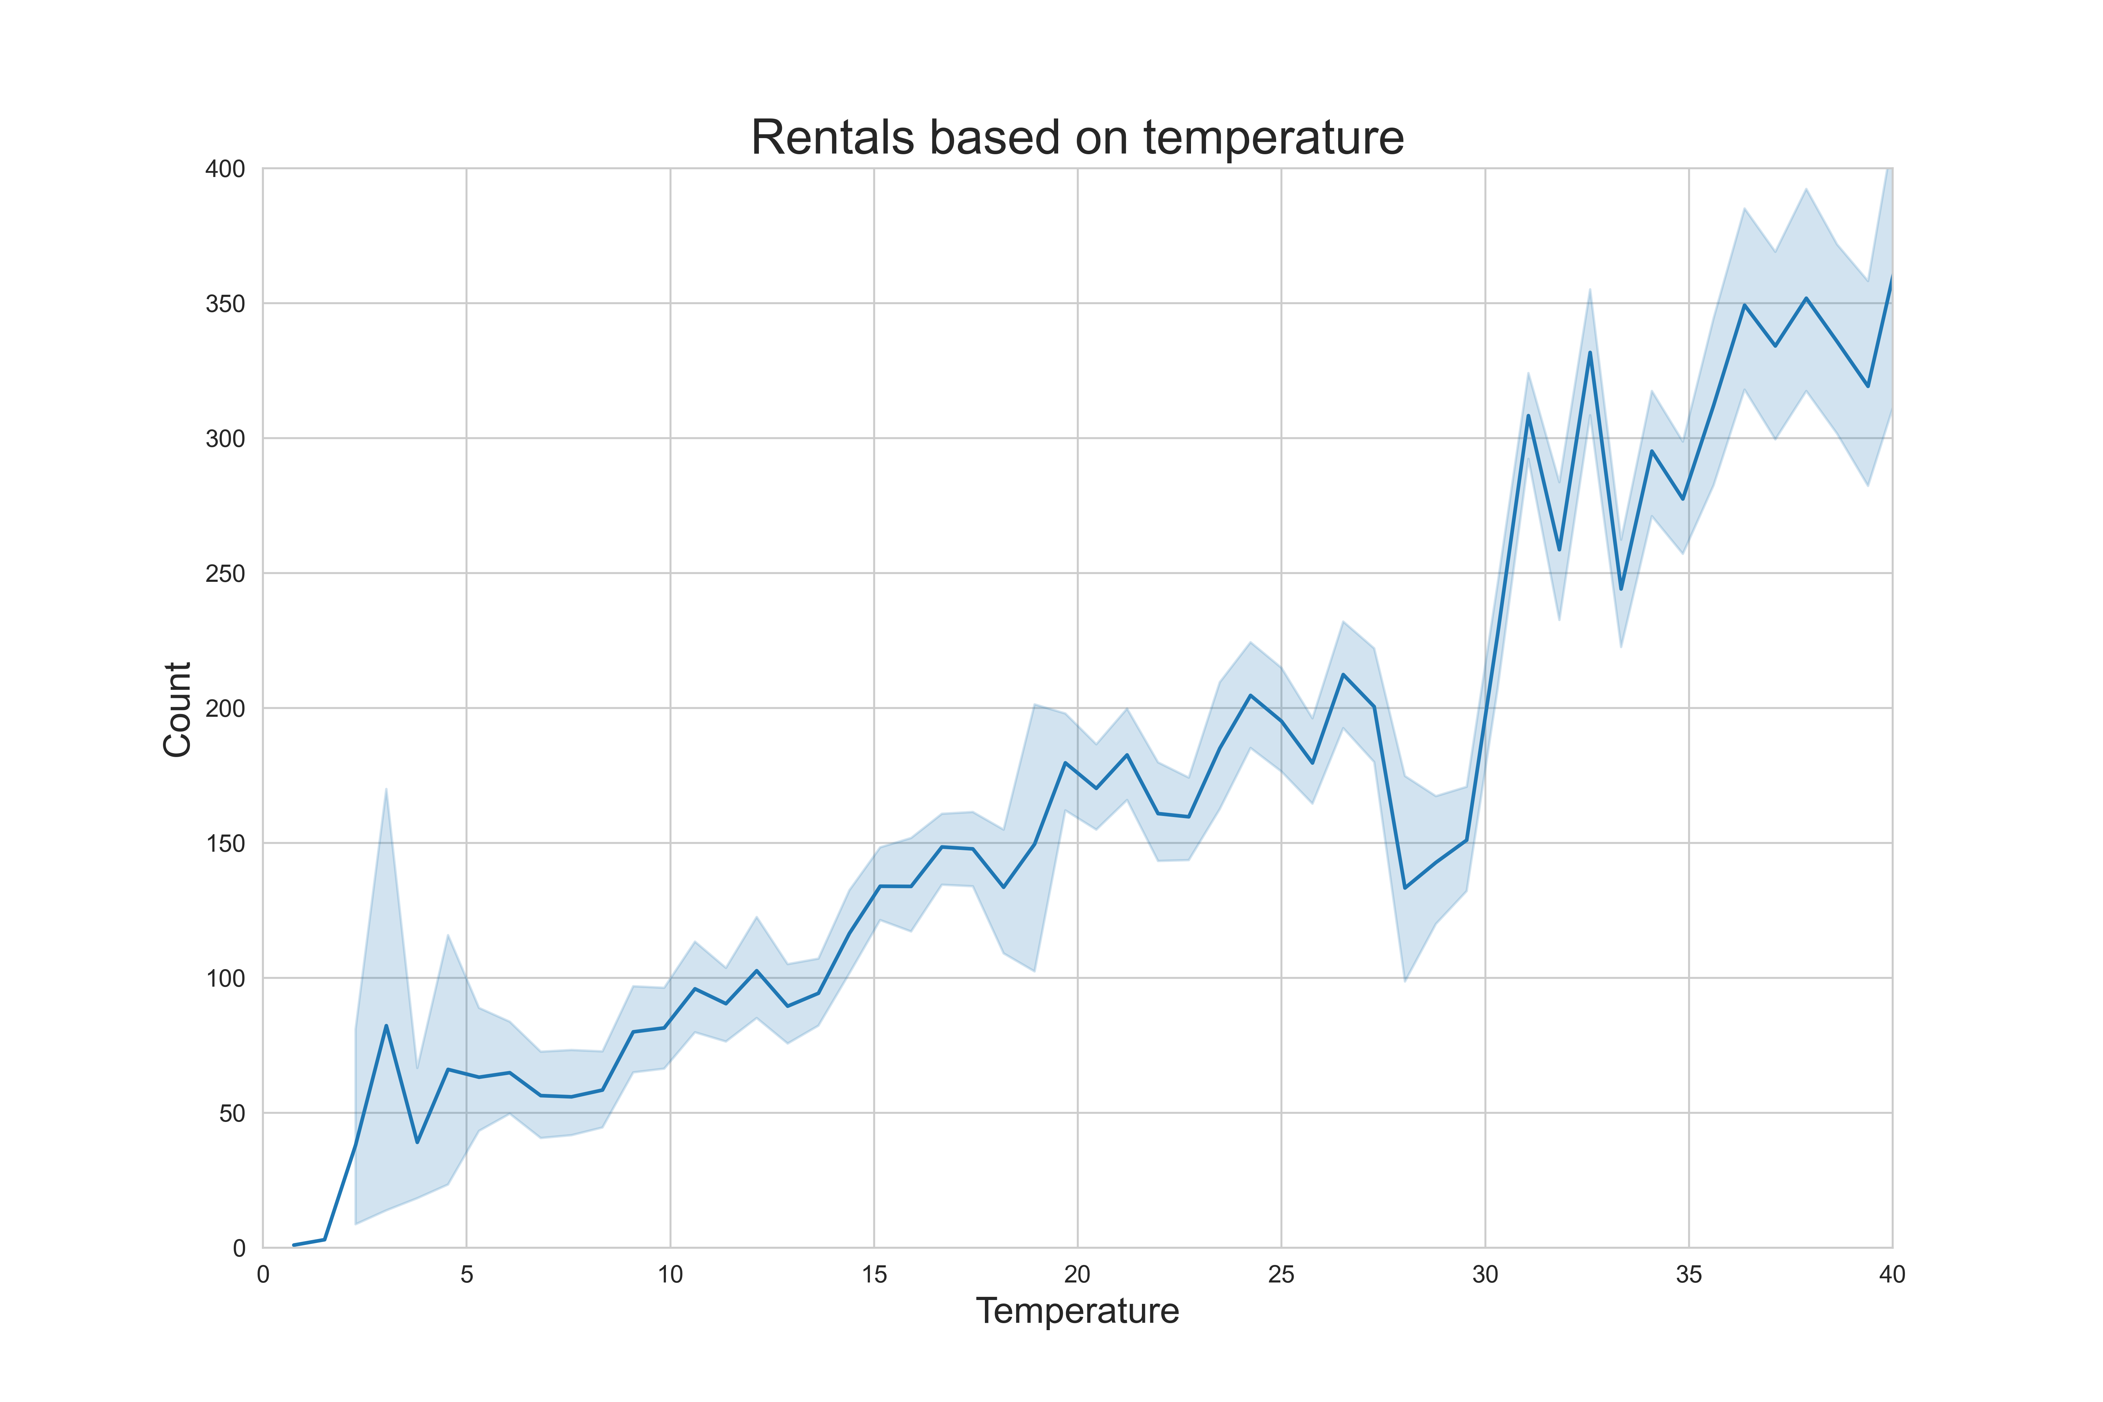

Slide 7
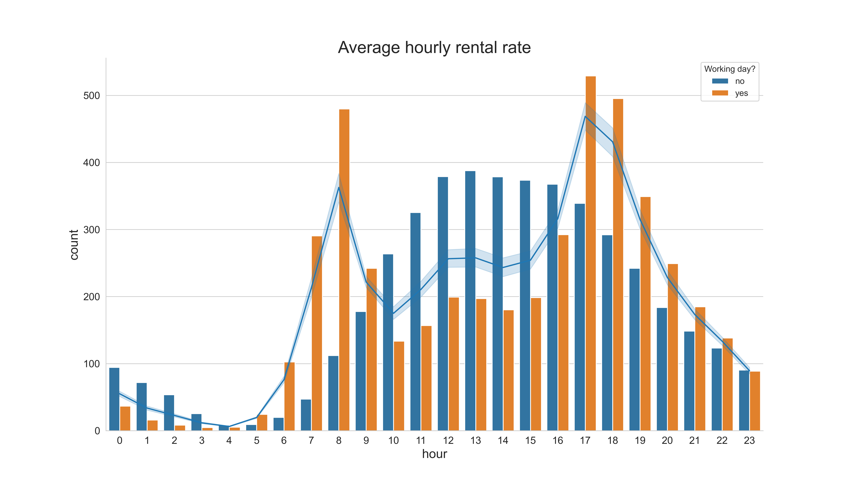

Slide 8
02
Various models
(AI)

Slide 9
Regression models
(a) Terribly inaccurate models
Linear Regression – 0.35
SVR – 0.34
Ridge/Lasso/ElasticNet 0.35
(b) Acceptable model
Random Forest Regression 0.86
Hypertuning → Default settings

Slide 10
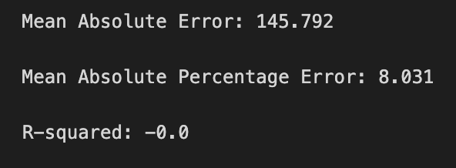
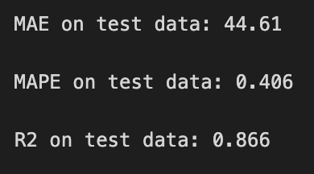
Results & considerations
(c) Results
(d) Extreme values are a weak point

Slide 11
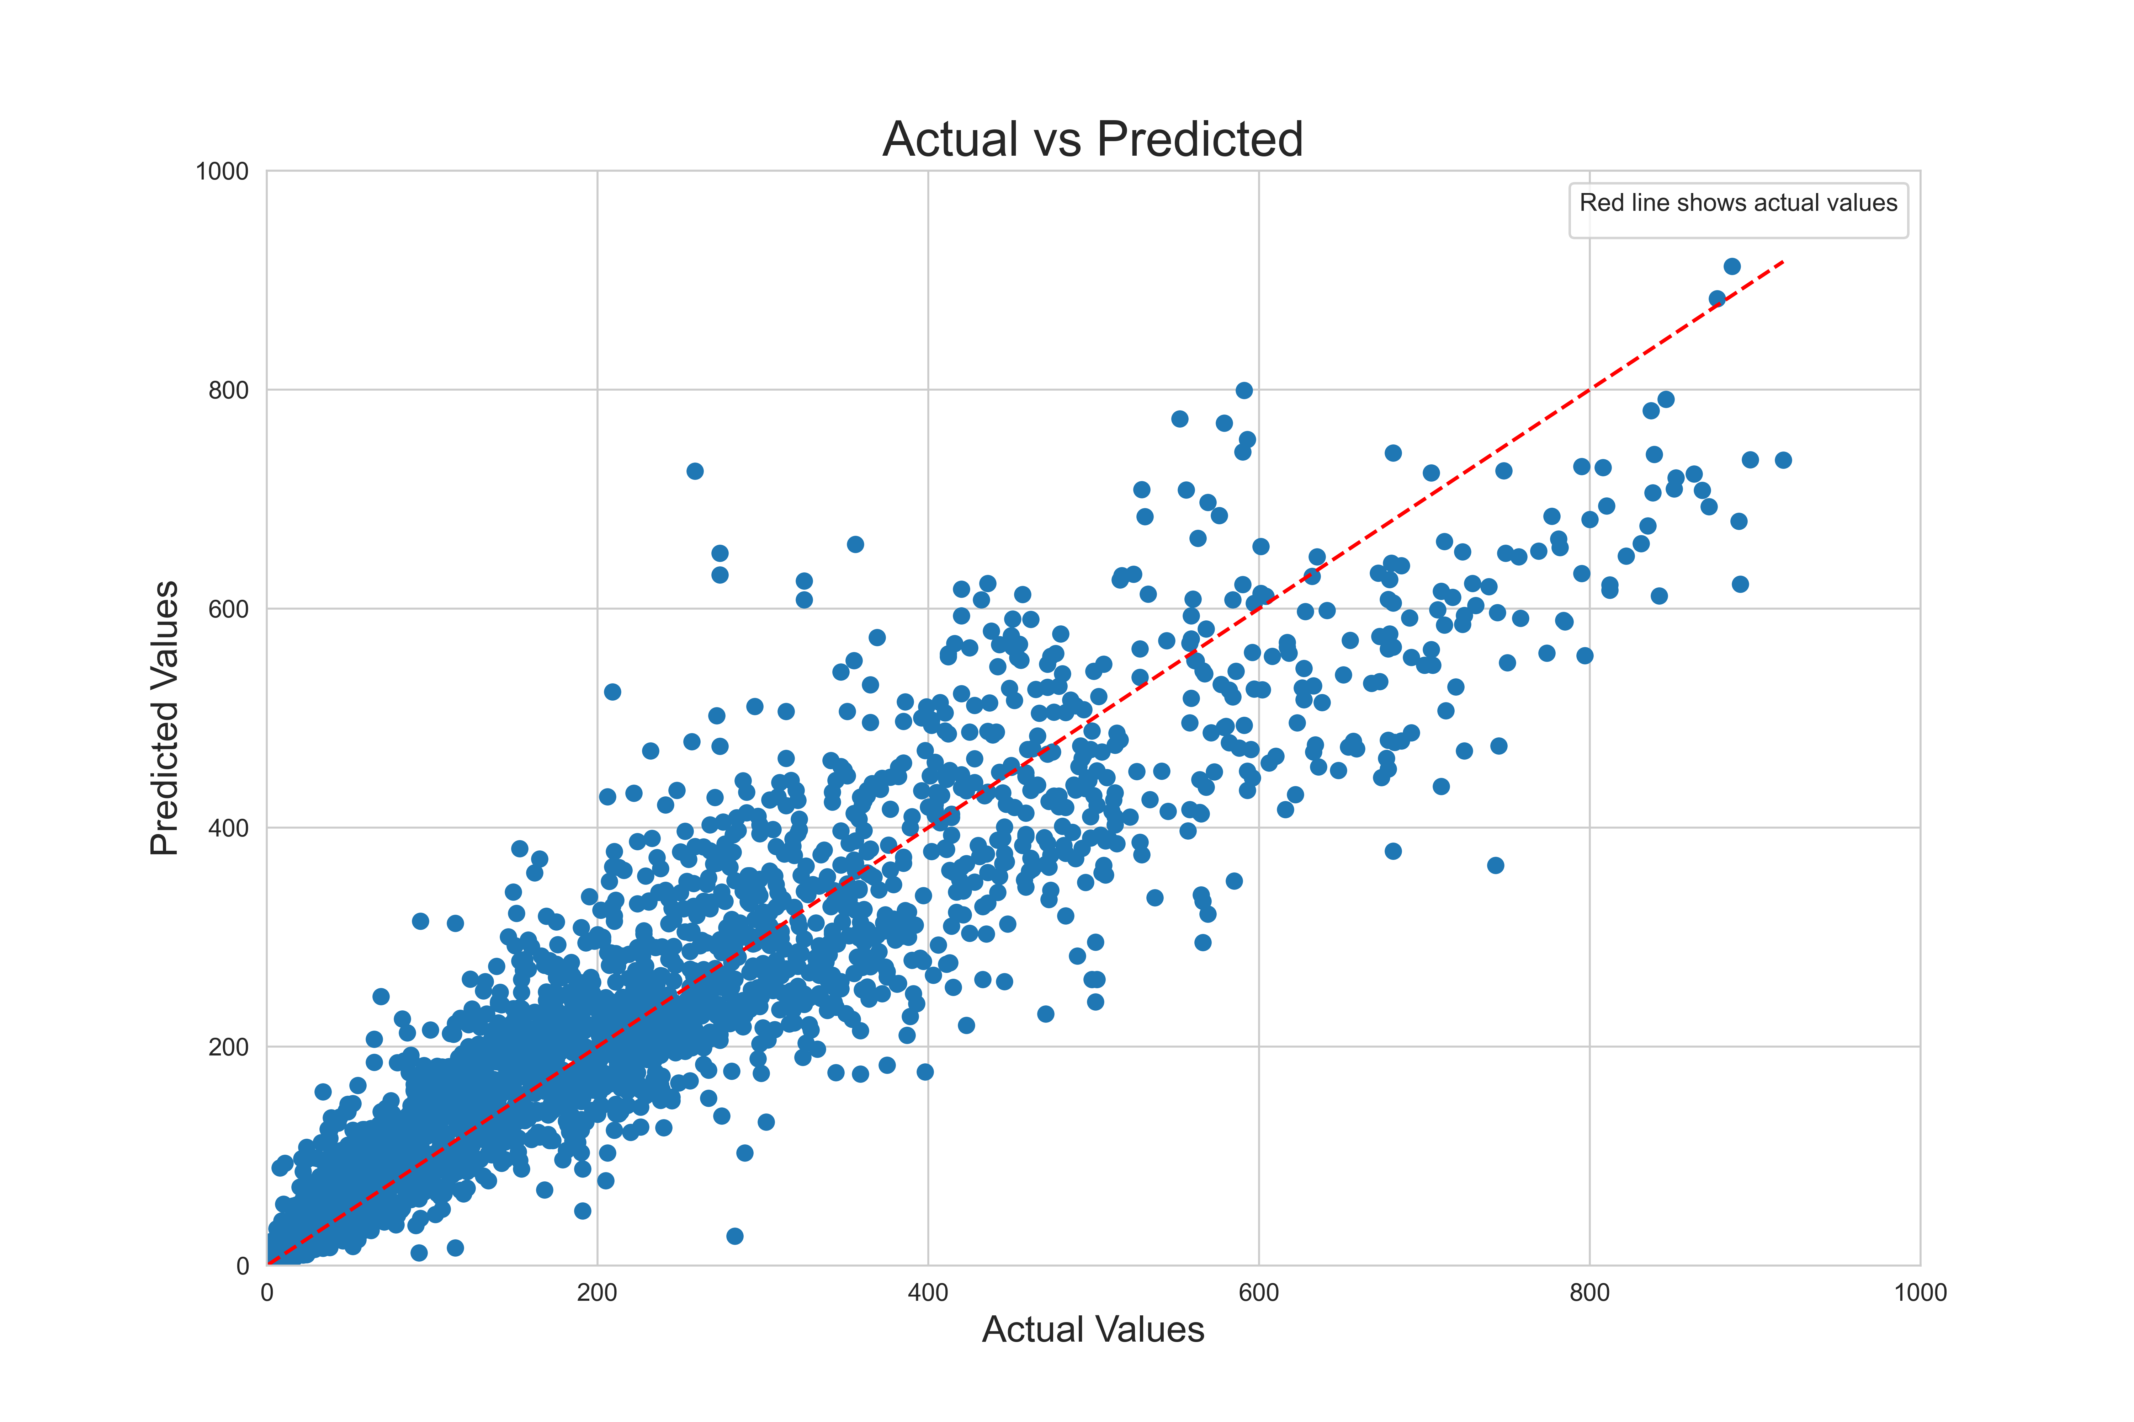

Slide 12
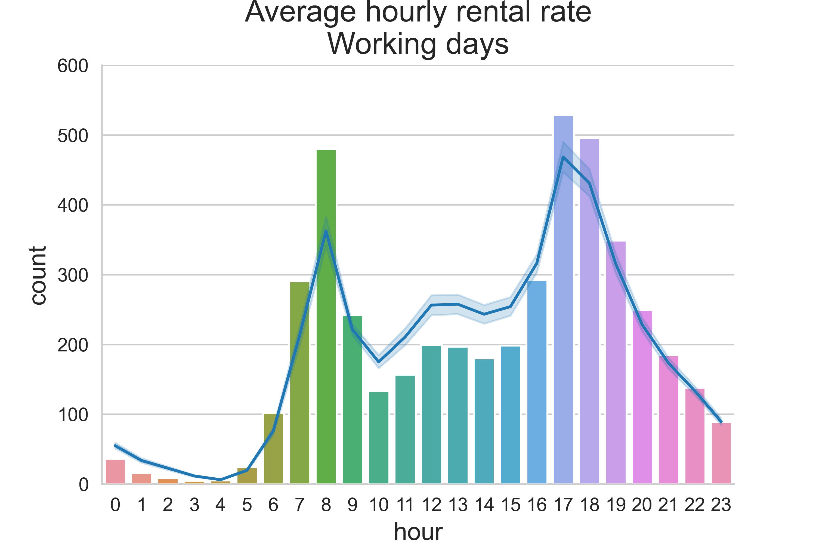
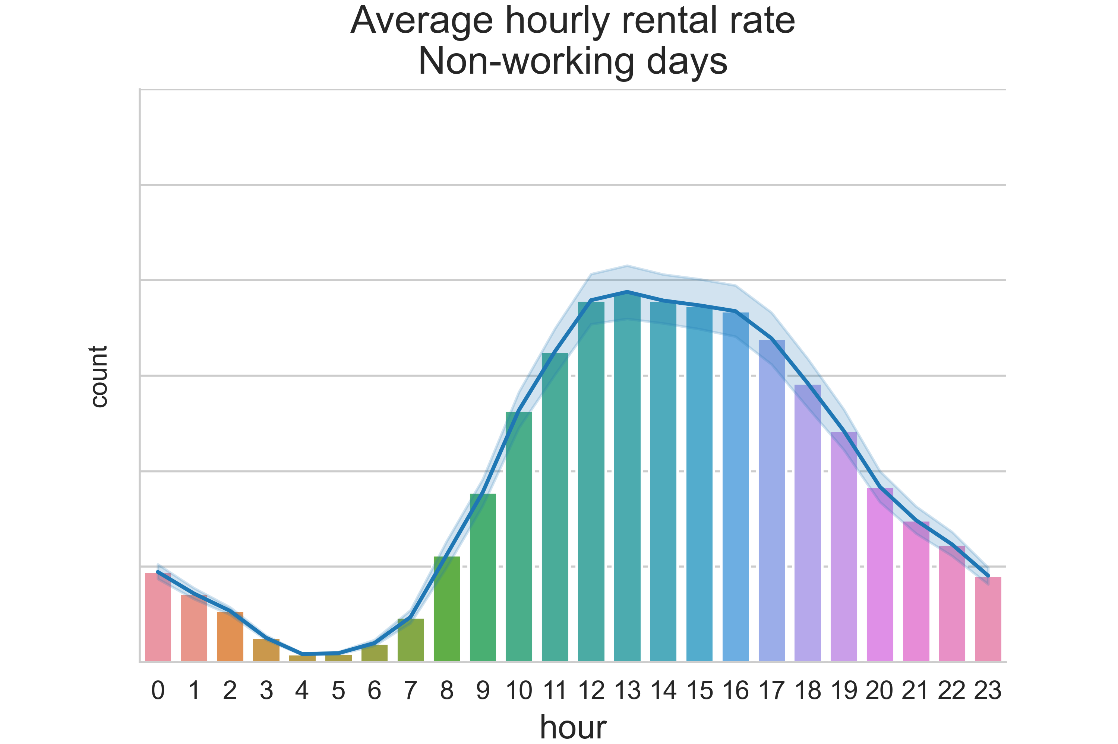

Slide 13
03
Conclusions
(a) The model
Did not account for polynomial variation in data
(b) Spend more time on ’high-level’ question
(c) More time for presentation

Slide 14
Thanks!
Please, keep this slide as attribution

